Slide 1
TIP: Time-Proportional Instruction Profiling
Internals of CPU Profiling with different instruction sets and architectures
Gufran Baig
#G01387617

Slide 2
How to evaluate CPU performance?
Basic idea behind this paper is to understand the different ways to profile the CPU performance.
We want to know how execution time is distributed across the instructions of a program.
Different CPU architectures and instruction sets makes it more difficult to do profiling.
Highly parallel execution model of processors makes analysis being unnecessarily challenging.

Slide 3
Outline
Introduction
Motivation & Background
Methodology
Experimental Setup
Results
Case Study
Conclusion

Slide 4
Introduction

Slide 5
Profilers
Profilers can be broadly divided into two categories
Software Level Profilers
Hardware Supported Profilers

Slide 6
Software Level Profilers
Software level profilers (Linux perf) interrupt the application and retrieve the address of the instruction.
Execution will resume from after the interrupt has been handled.
Gathering profiles software level profilers is inherently inaccurate

Slide 7
Hardware Supported Profilers
Hardware-supported profiling enables sampling in-flight instructions without interrupting the application.
All hardware profilers rely on sampling.
Profiler collects instruction address at regular time intervals.
Collection and their instruction selection policies differ.

Slide 8
Hardware Supported Profilers
Sample collection policies for hardware based profiles
Next Committing Instruction (NCI) heuristic.
Last Committed Instruction (LCI) heuristic.
Dispatch heuristic: Tag an instruction at dispatch and then retrieve the sample when the instruction commits.

Slide 9
Motivation & Background

Slide 10
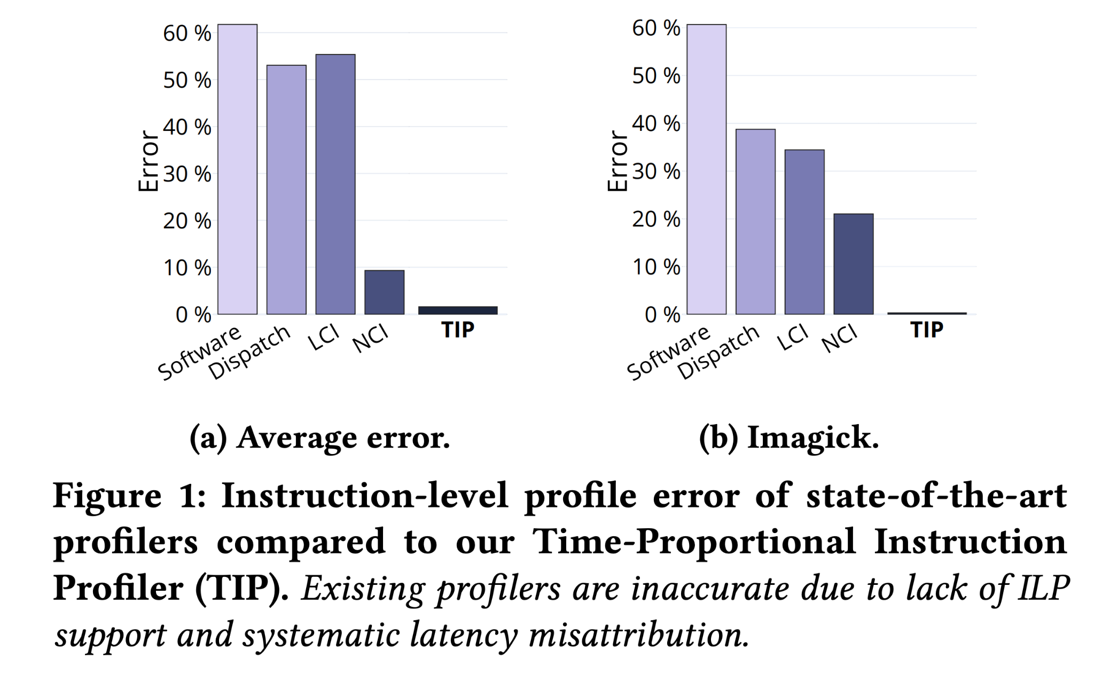
Comparing profiler error rates
Software-level profiling:
- 61.8%
dispatch tagging heuristic:
53.1%
LCI-heuristic:
55.4%
NCI-heuristic:
9.3%

Slide 11
Issues with state-of-the-art profilers
Existing profilers are inaccurate due to lack of ILP support and systematic latency misattribution
They do not account for ILP — incorrectly attributing the latency of co-committed instructions to only one of the instructions.
Suffer from systematic misattribution — attributing the latency of processor stalls to a different instruction than the one that caused the stall.
A CPU commits 𝑤 instructions cycle — implies processor has been able to hide all of the instruction latency except for 1/𝑤 cycles.

Slide 12
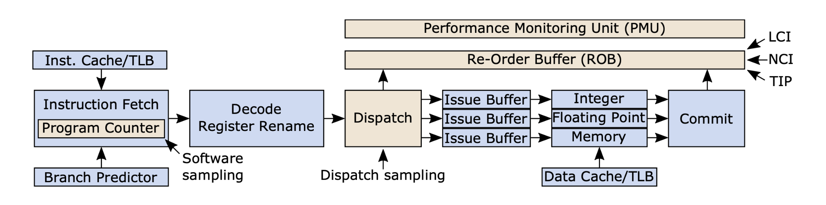
Sampling the Instructions
In software based profiler, sampling is done at the dispatch, while in LCI, NCI, and TIP sampling is done at the commit phase

Slide 13
Issues in Dispatch and Software Profiling
Dispatch and Software do not sample at commit phase.
Different instructions spend more time in some pipeline stages than others.
Time an instruction spends at the head of the ROB directly impacts the execution time.

Slide 14
Issues with LCI and NCI Profiling
NCI and LCI misattribute time.
Time spent resolving a mispredicted branch must be attributed to the branch and not some other instruction.
NCI systematically blames the instruction after a pipeline flush for stalls due to mis-speculation.

Slide 15
Profiling with TIP
TIP account for ILP at the commit stage and pipeline stall, flush and/or drain latencies.
Every clock cycle is attributed to the instruction(s) that the processor exposes the latency of.
The average instruction-level profile error of TIP is merely 1.6%.
TIP reduces average error by 5.8×, 34.6×, 33.2×, and 38.6× compared to NCI, LCI, Dispatch, and Software profiling, respectively.

Slide 16
Methodology

Slide 17
Oracle Profiling (TIP)
Oracle which is time-proportional by design.
Oracle attributes each clock cycle during program execution to the instruction(s) which the processor exposed the latency of in this cycle.
Oracle attributes 1/𝑛 clock cycles to each of the 𝑛 committing instructions.
Oracle profiling consists of four fundamental states for each clock cycle.

Slide 18
Oracle clock cycle attribution
If the ROB contains instruction(s), and if the processor is committing (an) instruction(s) in this cycle. Processor is in the Computing state.
If the processor is not committing instructions and there are instructions in the ROB, processor is in Stalled state.
If ROB is empty due to mis- speculation, the processor is in the Flushed state
If front-end is not supplying instructions, due to an instruction cache or instruction TLB miss, the processor is in the Drained state

Slide 19
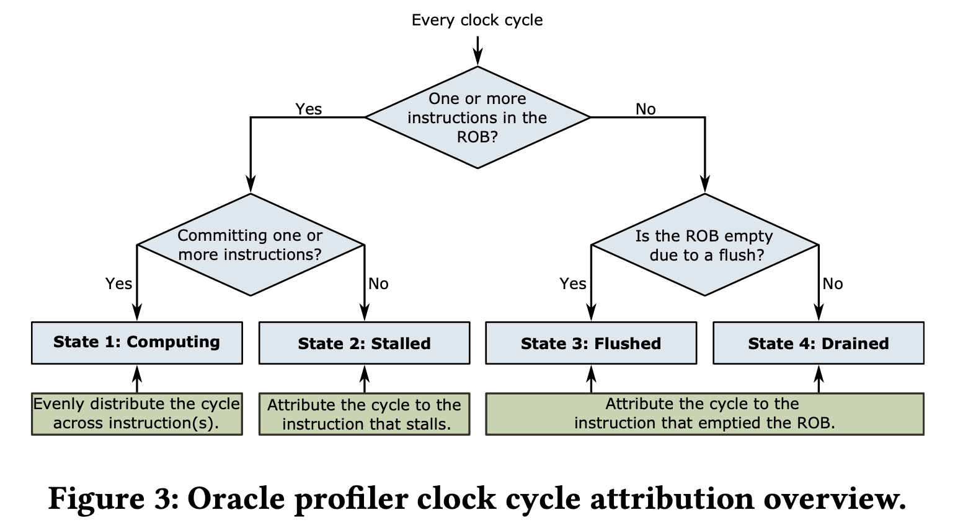
Oracle clock cycle attribution

Slide 20
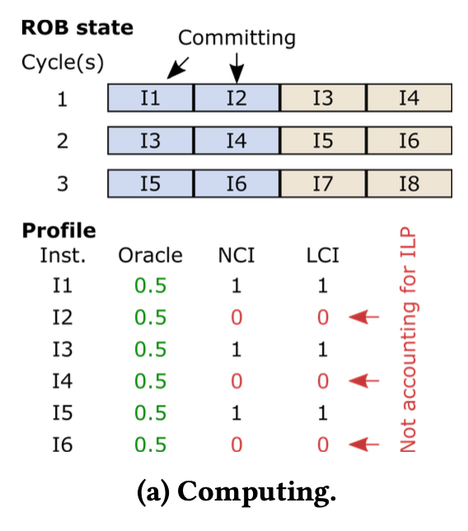
Computing State
Oracle accounts 1/𝑛 cycles to each committed instruction where 𝑛 is the number of instructions committed in that cycle.
In cycle 1, instructions I1 and I2 are committing and Oracle hence accounts 0.5 cycles to both.
In contrast, NCI and LCI select a single instruction to attribute the clock cycle to

Slide 21
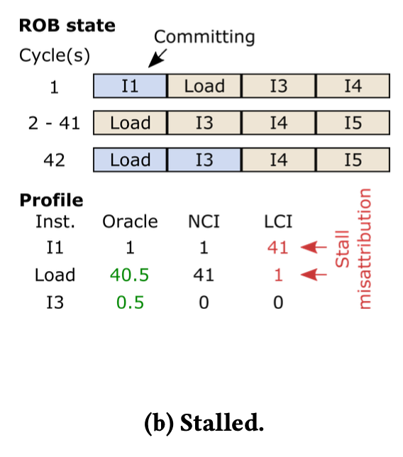
Stalled State
I1 is committed in cycle 1 before commit stalls for 40 cycles on the load instruction from cycle 2 to 41
Oracle attributes the 40 cycles where the processor is stalled to the oldest instruction that the processor is stalling on
LCI, completely misattributed the load stall as I1 is the last-committed instruction from cycle 1 to cycle 41

Slide 22
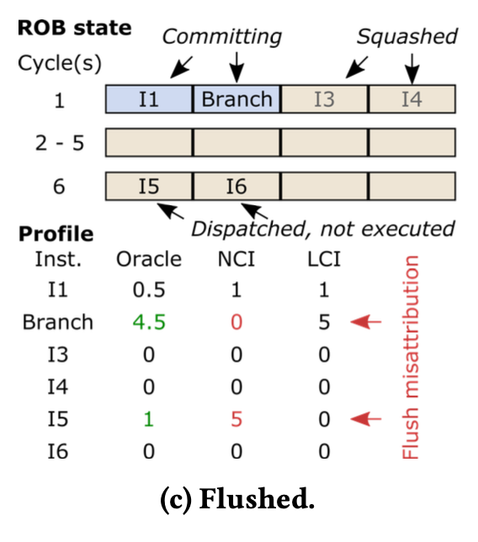
Flushed State
Branch misprediction lead to the ROB being empty for 3.5 cycles on average.
LCI correctly attributes the stall cycles to the mispredicted branch whereas NCI does not.
NCI attributes the empty ROB cycles to I5 as it will be the next instruction to commit
NCI attributes zero cycles to the branch instruction since it is committed in parallel with I1.

Slide 23
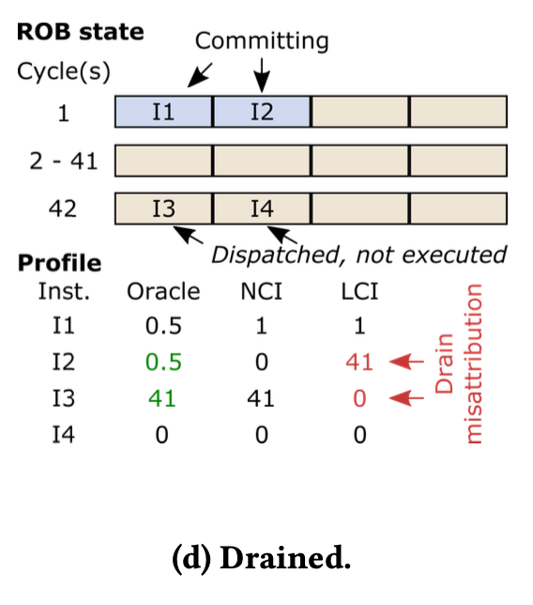
Drained State
In cycle 1, I1 and I2 are committed. This leaves the ROB empty until cycle 42.
Oracle attributes 41 cycles to I3;
40 cycles is due to the drain and one cycle is attributed because I3 is stalled at the head of the ROB in cycle 42.
LCI misattributed the empty ROB cycles to I2.

Slide 24
Putting all together
We have discussed the four fundamental states of the commit stage independently.
Instructions often accumulate cycles across multiple states.
Oracle will account time to the preceding instructions according to the time they spend at the head of the ROB.

Slide 25
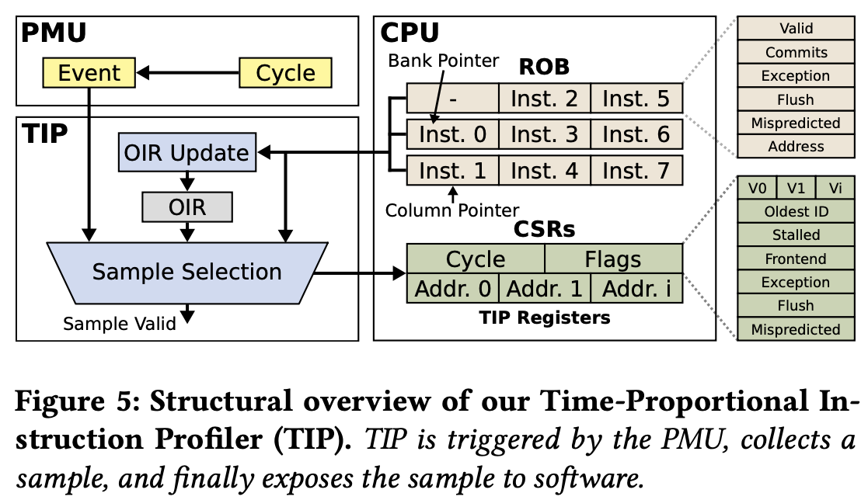
Oracle Structural overview

Slide 26
Experimental Setup

Slide 27
Simulator
We use the FireSim cycle-accurate FPGA-accelerated full-system simulator to evaluate the different performance profiling strategies.
The simulated model uses the BOOM 4-way superscalar out-of-order core.
Hardware profilers are enabled when the system boots and profile until the system shuts down.
A modified version of FireSim is used to trace instruction address and the valid, commit, exception, flush, and mispredicted flags.

Slide 28
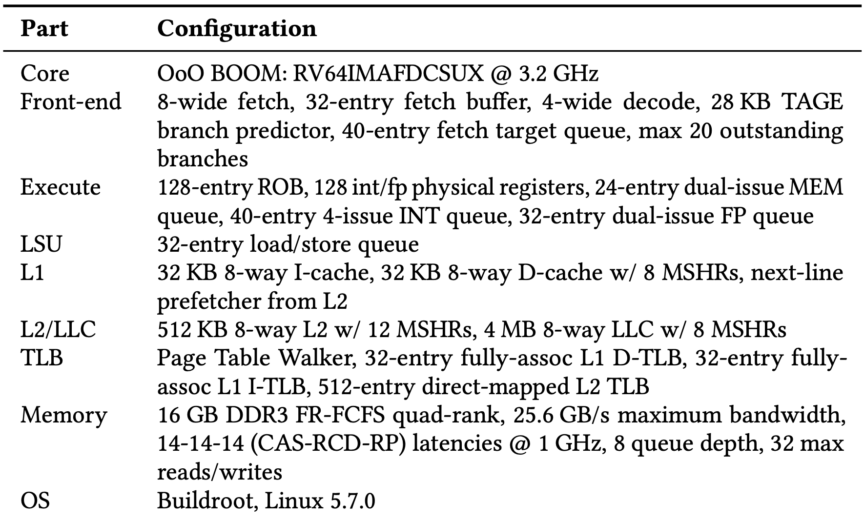
Simulated Configuration

Slide 29
Benchmarks
Cycle stacks is used to classify benchmarks
Benchmark is classified as Compute-Intensive if it spends more than 50% of its execution time committing instructions.
Benchmark spends more than 3% of its time on pipeline flushing, the benchmark is classified as Flush-Intensive.
Rest of the benchmarks are classified as Stall-Intensive as they spend a major fraction of their execution time on processor stalls.

Slide 30
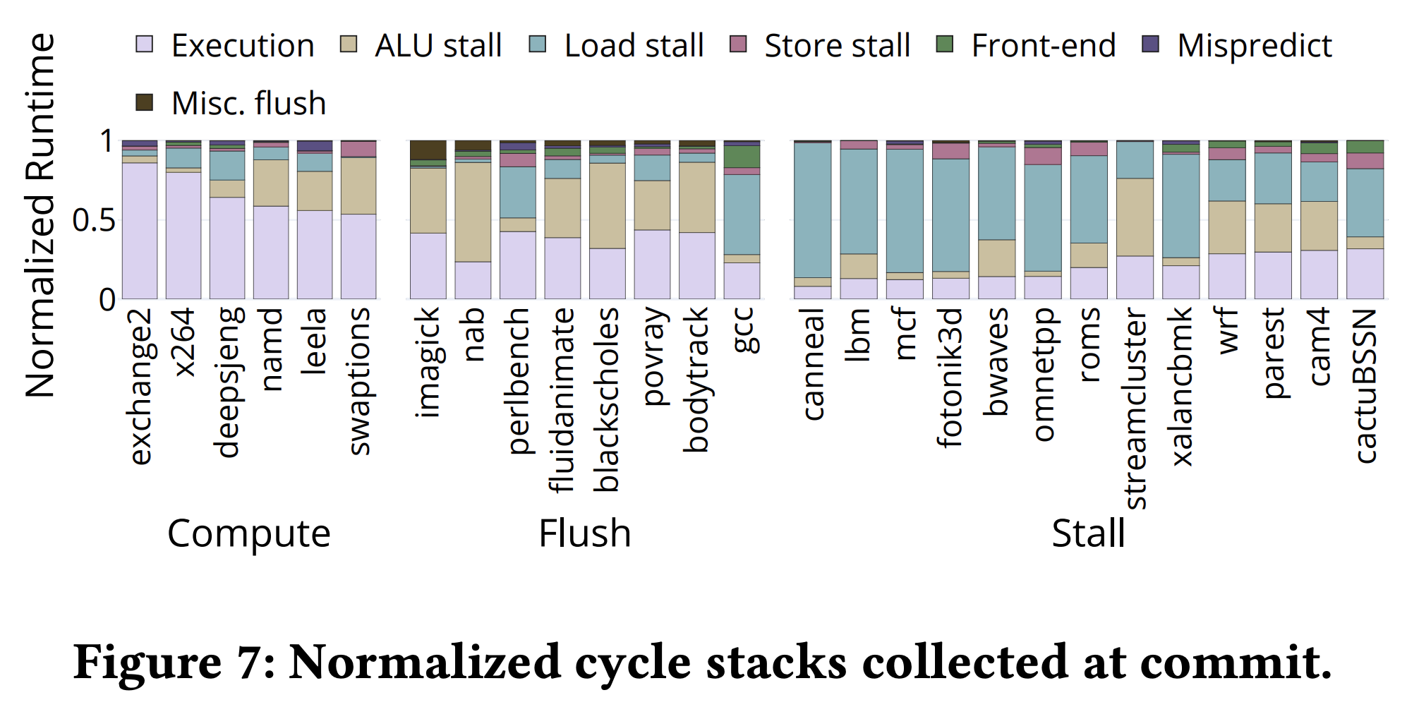
Benchmarks

Slide 31
Results

Slide 32
Comparing profiler errors
Profiling can be done at different level of granularity
Function-level profiling reports error at the function level across all the profilers considered.
Basic-block-level profiling Correctly attributing samples to functions does not necessarily mean that a performance analyst will be able to identify the most performance-critical basic blocks.
Instruction-level profiling Performance analysts need profiling information that is even more detailed than the basic block (and function).

Slide 33
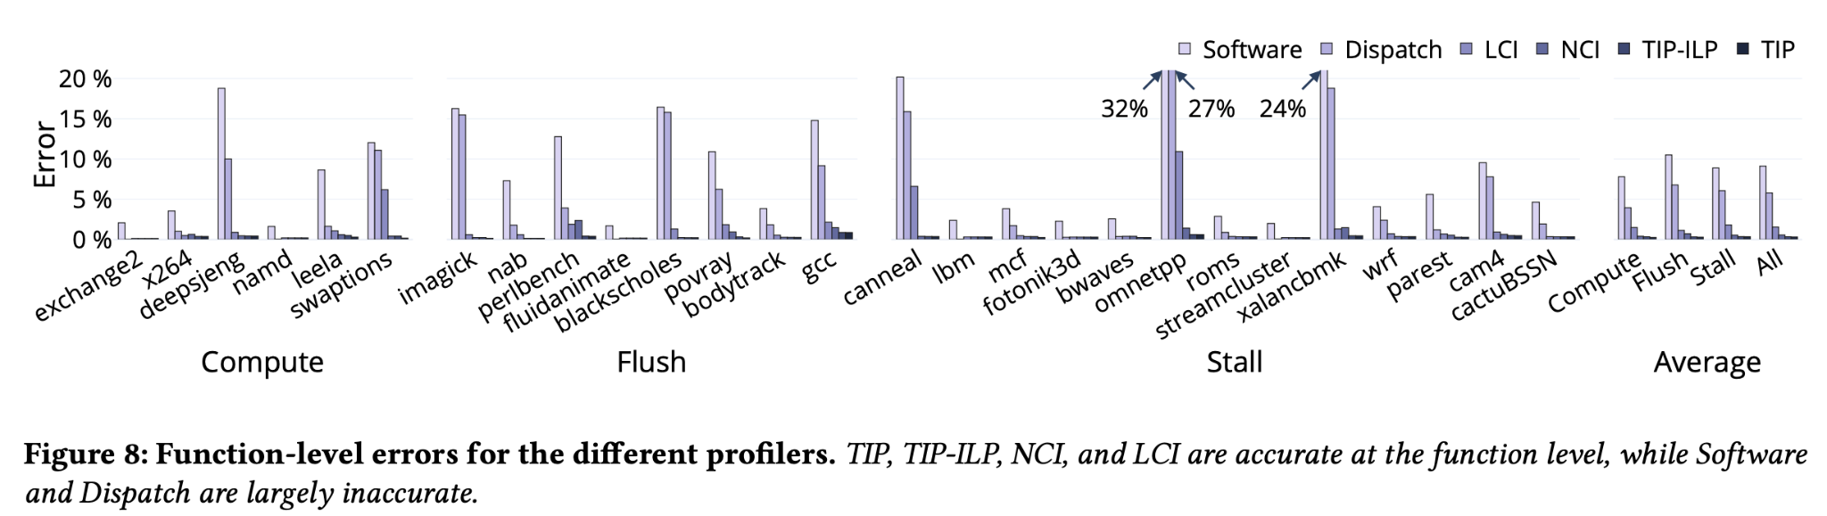
Function-level profiling
All profilers, except Software and Dispatch, are accurate at function-level granularity.
Software and Dispatch are inherently inaccurate, because tagging instructions at fetch and dispatch creates significant bias

Slide 34
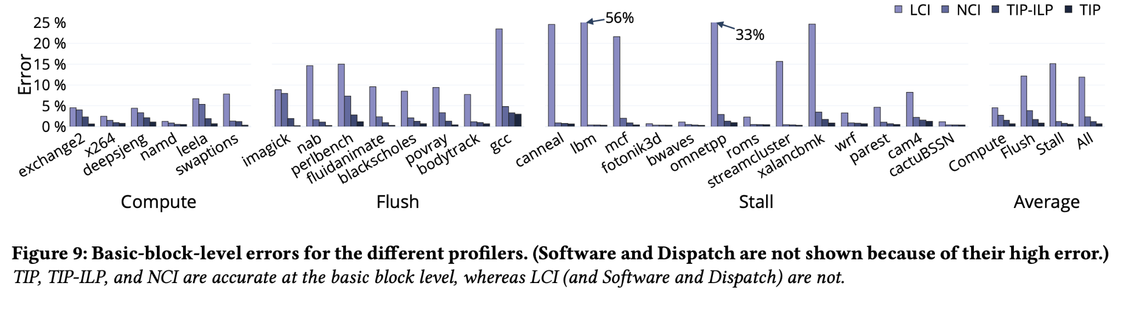
Basic-block-level profiling
LCI is inaccurate with an average error of 11.9% and up to 56.1% because it incorrectly attributes stalls on long-latency instructions
Error is higher at the basic block level compared to the function level for all profilers

Slide 35
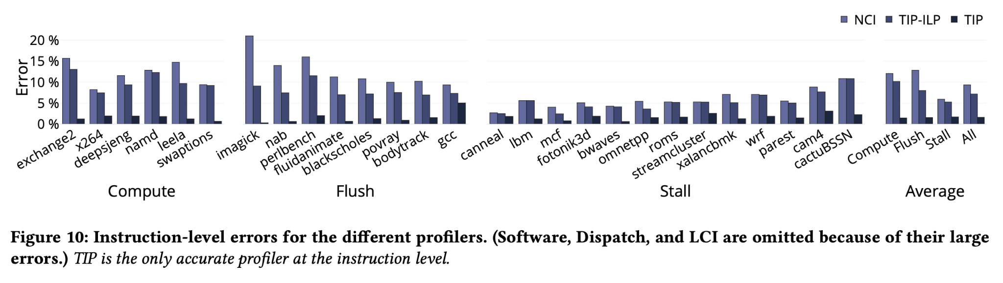
Instruction-level profiling
TIP is the only accurate profiler at the instruction level, average profile error for TIP equals 1.6%
It provides profiling information that is even more detailed than the basic block and function level profiles

Slide 36
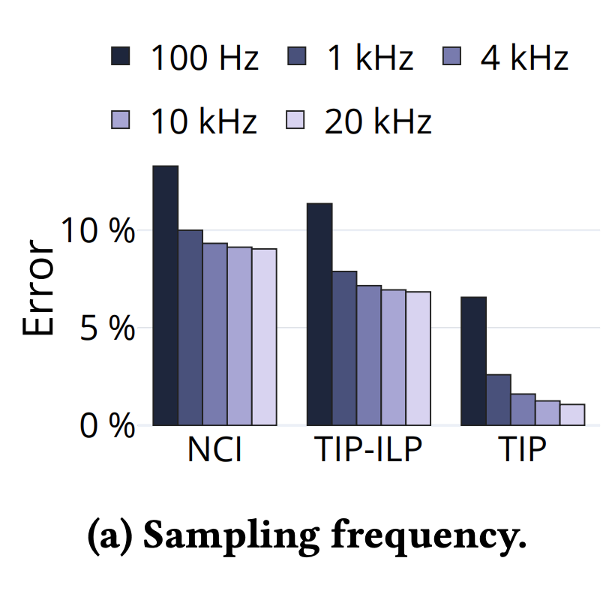
Sampling Rate
Profiling error decreases with increasing sampling frequency; and this is true for all profilers.
lower frequencies as these have more unsystematic error.
TIP’s accuracy continues to measurably improve as the sampling frequency is increased beyond 4 KHz

Slide 37
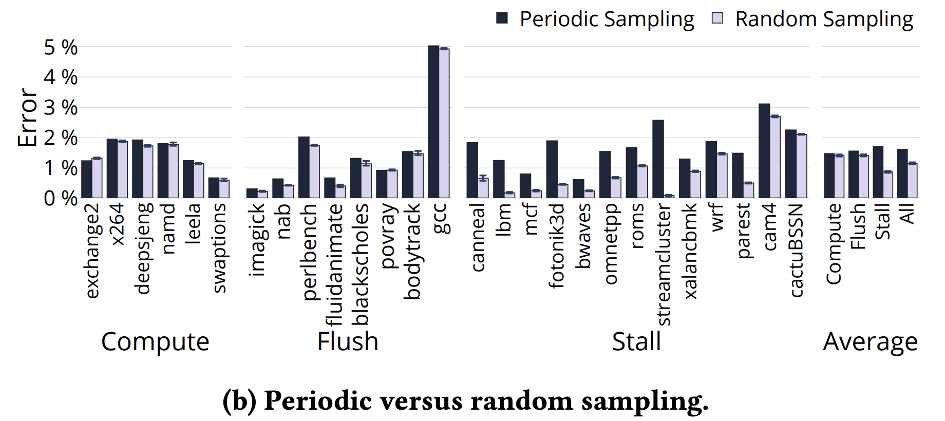
Sampling method
Periodic sampling is only slightly more inaccurate than random sampling.
Periodic sampling is simpler to implement in hardware as compared to random sampling.

Slide 38
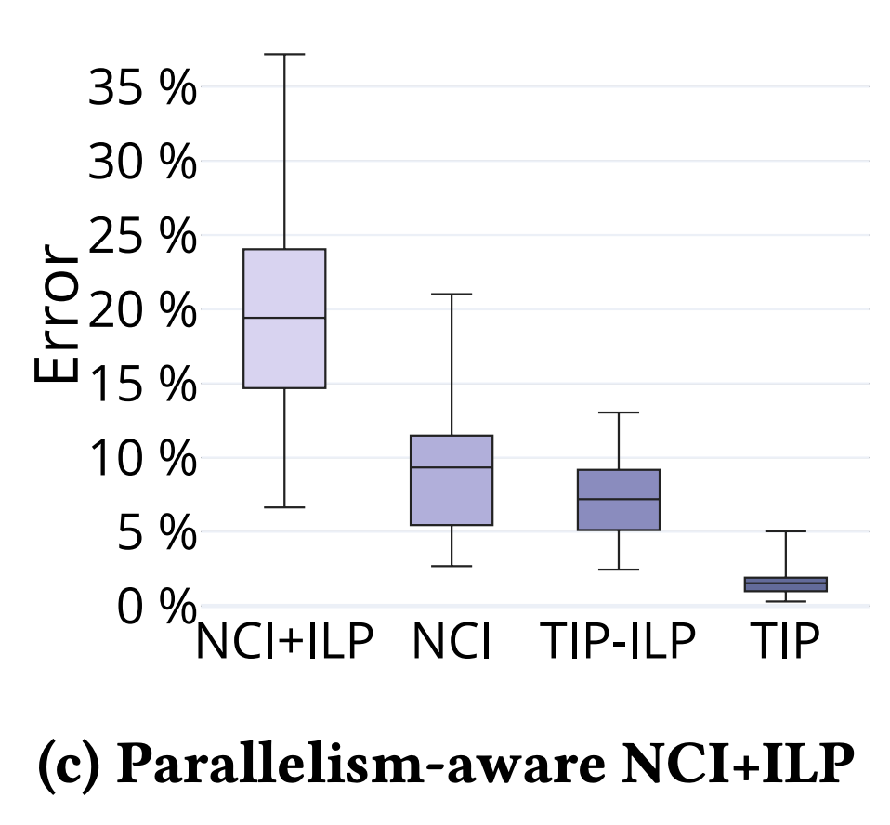
Commit-parallelism-aware NCI
TIP is more accurate than NCI.
It correctly accounts for pipeline flushes and commit parallelism.
Making NCI commit parallelism aware increases profile error, in contrast to TIP

Slide 39
Case Study

Slide 40
SPEC CPU2017 benchmark Imagick
Perform SPEC CPU2017 benchmark Imagick to illustrate how TIP pinpoints the root cause of performance issues.
The function-level profile does not clearly identify any performance problem.
The instruction-level NCI profile attributes most of the execution time to the feq.d and the ret instructions.
TIP correctly reports that most of the time in ceil is spent on the frflags and fsflags instructions.

Slide 41
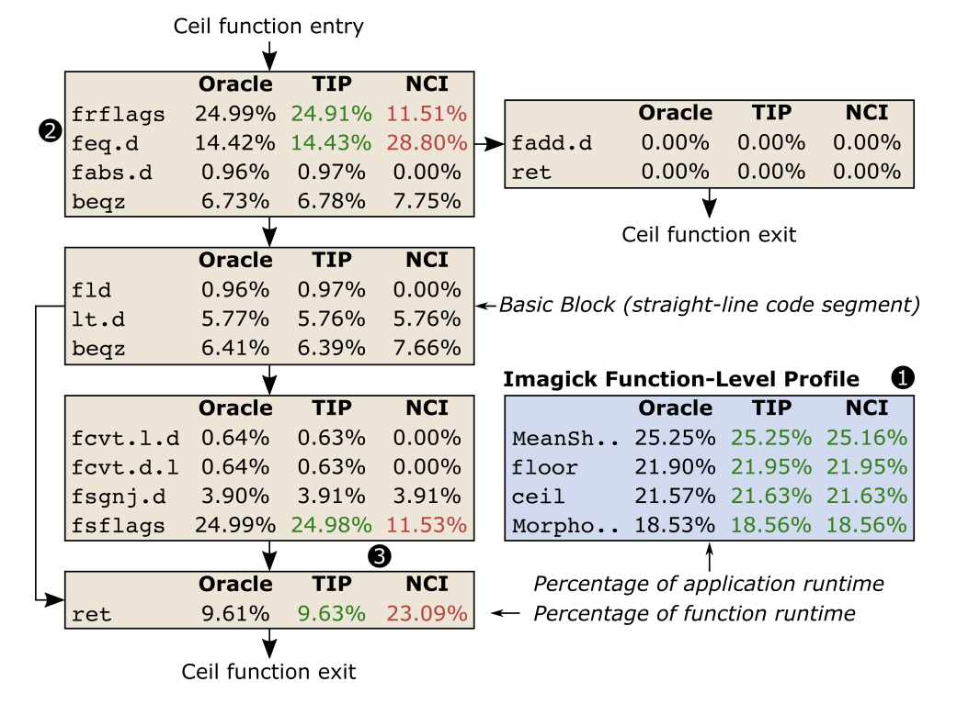
SPEC CPU2017 benchmark Imagick

Slide 42
Optimized Imagick benchmarks
Perform SPEC CPU2017 benchmark with optimized Imagick
Both ceil and floor spend significant time on ALU stalls and front-end stalls.
Optimized Imagick’s code by replacing frflags and fsflags in ceil and floor with nop instructions to remove the unnecessary status register operations.
Optimized version improves performance by 1.93× compared to the original version.
Speedup is based on the fraction of time spent executing the frflags and fsflags instructions.

Slide 43
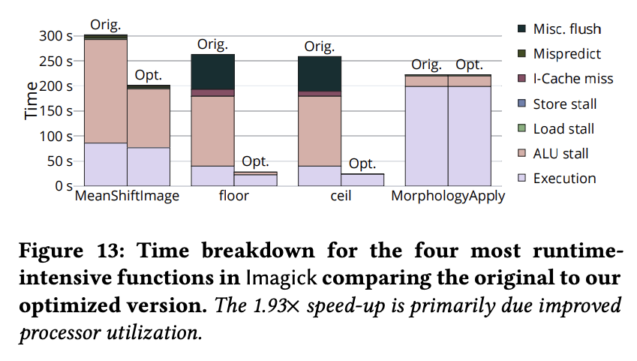
Optimized Imagick benchmarks

Slide 44
Conclusion
Existing profilers fall short because they they lack ILP support and systematically misattribute instruction latencies.
TIP account for ILP at the commit stage and pipeline stall, flush and/or drain latencies.
TIP is highly accurate profiler, average instruction-level profile error of TIP is merely 1.6%

Slide 45
Questions ?

Slide 46
Thank You :)

Slide 47
References :)
https://doi.org/10.1145/3466752.3480058%20MICRO%202021

